Slide 1
Lab meeting 29/11/19
Flow cytometry
&
Lipid rafts

Slide 2
Flow cytometry

Slide 3
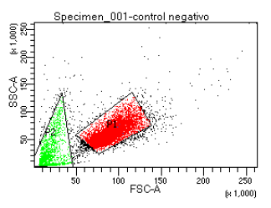
Mitochondrial dyes test
Negative control
Dyes | Detects | Control
TMRM | Mitochondrial membrane potential (ΔΨm) | FCCP
MitoSOX (2-4 µM) | Superoxides | Rotenone Antimycin A

Slide 4
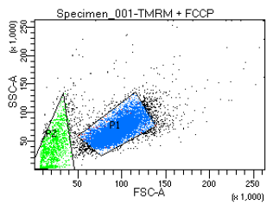
Mitochondrial dyes test
TMRM
TMRM+FCCP

Slide 5
Mitochondrial dyes test
MitoSOX 2µM
MitoSOX + Ant/Rot

Slide 6
MTK Red + Green N2A (IMDEA)
Control -
MTK Red control
MTK Green control

Slide 7
MTK Red + Green N2A (IMDEA)
CM
miR7

Slide 8
MTK Red + Green (IMDEA)
Repeat with technical triplicates

Slide 9
Lipid rafts

Slide 10
Caveolin-1 silencing: basal-starvation conditions and rapamycin treatment
Caveolin 1
¿?
Starvation
Rapamycin
mTORC1
ATG5
ATG12
Autophagy
+

Slide 11

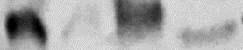
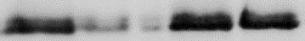
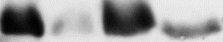
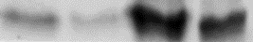
Caveolin-1 silencing: basal-starvation conditions and rapamycin treatment
Basal-Starvation
Rapamycin
NS Cav1
Si Cav1
Basal
Starvation
NS Cav1 + Rapamycin
Si Cav1 + Rapamycin
NS Cav1
Si Cav1
ATG5
ATG5
Cav-1
Cav-1
NS Cav1
Si Cav1
Basal
Starvation
ATG5
Starvation
Caveolin 1
Cav-1
Rapamycin
mTORC1
ATG5
ATG12
Cells: EA.hy926 (transformed human umbilical vein endothelial cells)
Autophagy
+

Slide 13

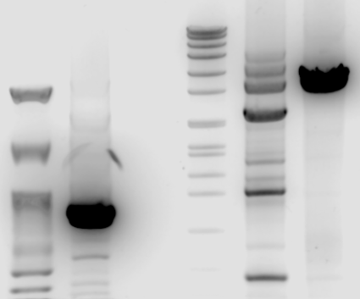
hDHCR7, hDHCR24 & hSC5D – primers test
Nippon 100pb
hDHCR7 fw1/rv1
Marker VII
hDHCR24 fw3/rv3
hSC5D fw6/rv6
8576
7427
6106
3’UTR | Size (bp) | miRNA site type
hDHCR7 | 871 | 7mer-m8
hDHCR24 | 2548 | 7mer-A1
hSC5D | 3425 | 8mer, 7mer-m8
4899
~3425bp
3639
3000
2799
1953
1882
1500
1515
1482
1164
1000
~871bp
992
900
710
500
400
300

Slide 14
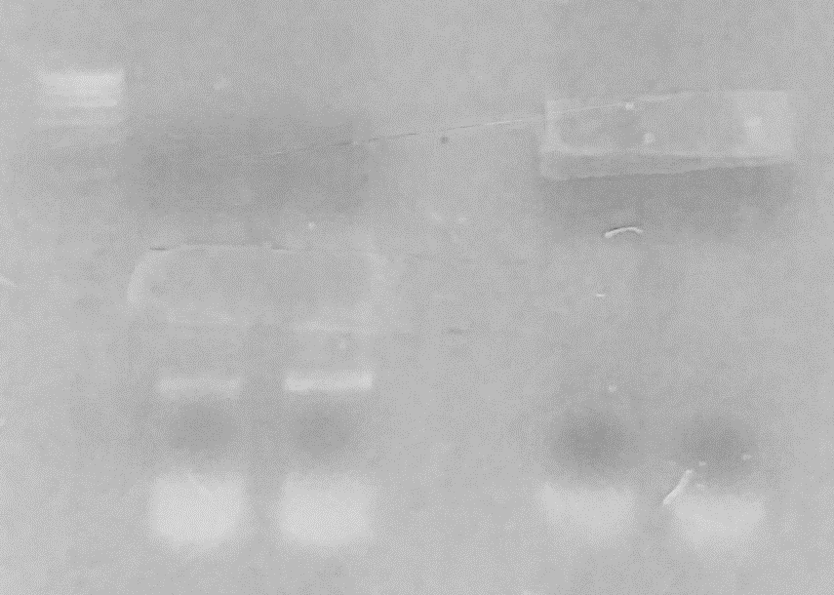
hDHCR7 & hSC5D – insert amplification
Marker VII
hDHCR7
hSC5D

Slide 15
Cloning – In progress
Cloning of 3’UTRs hDHCR7 and hSC5D in psiCHECK2 plasmid
Luciferase assay of cloned 3’UTRs
Point mutation of 3’UTRs
mDHCR24
hDHCR7
hSC5D
mSC5D sequencing with primers located in the middle of the sequence

